Slide 1
An Overview of a Strategic Planning Approach: USFWS Coastal Conservation and Partners for Fish and Wildlife Programs 2012-2016
Neil Stichert
October 16, 2012

Slide 2
Planning Purpose
Provide direction to programs, regions, field stations, and staff
Increase accountability
Define priorities and actions
Marketing/demonstration documents to funders

Slide 3
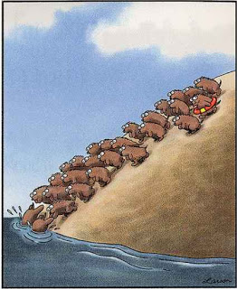
Planning Process
Implemented nationally in 2011 as the second iteration of PFW and CP programmatic plans
National template was developed and contained required plan elements
National ‘Vision Document’ was stepped down to 8 USFWS Regions
One year development and completion date
Unfunded

Slide 5
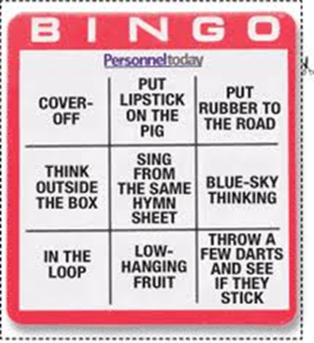
Plan Development
Staff briefings, readings, and assignments
Partner outreach and focus group meeting
SWOT exercises led by field staff
SWOT responses and meeting themes written into short reports

Slide 6
Plan Development
Drafts written and edited from field stations
Combined into regional document
Formatting and layout enhancements– important!
Completion

Slide 7
Plan Elements
The primary Goals of the Alaska Coastal Program are to:
1. Conserve coastal habitat.
2. Broaden and strengthen conservation partnerships.
3. Improve information-sharing and communication.
4. Enhance program workforce.
5. Strengthen program accountability

Slide 8
Plan Elements
Objectives:
1. Identify important habitats for species of concern within geographic focus areas.
2. Carry out priority conservation actions (i.e., assessment and prioritization of habitats, protection and restoration of key habitats, and outreach).
3. Leverage existing and/or new partners and funding sources to execute strategic actions.
4. Maintain workforce expertise and working relationships with other Service programs in order to sustain the diverse biological, planning, project management, and assessment skill sets.

Slide 9
Plan Elements
Guiding Principles:
1. Does the action significantly benefit Service trust species and Service priorities?
2. Does it support the needs of our partners and existing partnerships (e.g., NFHP, LCCs)?
3. Does it enhance habitat connectivity between federal, state, or local designated fish and wildlife habitat areas?
4. Does the action strengthen relationships with partners and their capacity to help the Service meet its mission?
5. Does the action leverage additional non-federal funds and in-kind support?

Slide 10
Planning Lessons: SWOT Exercises: Be prepared for unvarnished and/or contradictory feedback
Strengths of program: <verbatim responses>
Technical support and expertise
Responsiveness & flexibility
Diverse funding sources & blending applicable funds
Bringing partners/cooperators together
Capacity and funding mechanisms to work with private landowners
Flexibility to fund assessments, planning efforts, educational programs rather than just “on the ground” projects
Putting a “personable face” to the bureaucracy
Willingness to work with other agencies/partners for best results & solutions
Desire to solicit valuable feedback from partners/cooperators
Access to personnel in field
Focus on result-driven projects supported by science
Inclusion of municipalities, tribes, nonprofits, individuals, etc. in programs
Effectiveness of staff
Broad reach
Selection of projects that are visible in communities
List Weaknesses of program:
Excellent staff spread thin
Small grants very helpful but require same reporting as large grants
More projects than personnel
Programs have a lot of overlap
Coastal program seems almost too broad-reaching
Paperwork burdens
Lack of technical assistance
Limited access to partners programs does not increase partnerships with non-profits & other citizen groups
Field offices may be spread too thin for maximum productivity/awareness of needed projects/focus
Too many organizations competing for limited funds
Lack of multi-year/multi-phase grants
Overly dependent on partners to do the work
History of only focusing on projects solely benefiting FWS

Slide 11
Planning Lessons: Having a template helps with shaping a message but hurts creativity and constrains thinking
SEAKFHP should review effective plans and find existing guidance documents, but convene a robust process to determine its role, course, and partnerships.

Slide 12
Planning Lessons: Asking for and reviewing partner priorities was a useful exercise, but doesn’t define your own.
Partner Priorities
Conservation of vital natural areas on private land
Restoration and conservation of marine species and the habitats, including estuaries, marine environments, and freshwater habitats critical to anadromous species
The environmental sustainability of the Mendenhall watershed
Augmenting and enriching our conservation education programs through collaborations (conservation and research projects, preferably involving youth)
Protecting and/or restoring natural areas adjacent to schools, or that are especially well suited to conducting educational programs (Fish Creek, Eaglecrest area, Dredge Lakes, Mendenhall River corridor, Mendenhall Wetlands, Montana Creek, Sandy Beach, Gold Creek and Basin Road, Auke Lake; Duck, Jordan, Vanderbilt, Switzer, and Lemon Creeks)
Focus on wetland mitigation & outreach education.
Invasive plants management and eradication.

Slide 13
Plan Outcomes
Established performance benchmarks for Programs to achieve
Defines the Program themes and priorities within a broad partnership climate
Serves as a ready reference for staff
Serves as a briefing document during times of attrition.

