Slide 1
Watershed Condition Framework Overview
SEAKFHP Strategic Planning Meeting
Sheila Jacobson, Fisheries Biologist
October 2012

Slide 2
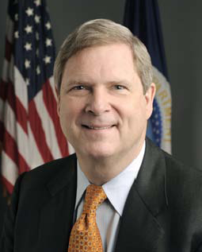
Watershed Condition Framework Roll-out
"Clean, healthy forests are vital to our efforts to protect America's fresh water supply.”
"Our nation's economic health, and the health of our citizens, depends on abundant, clean and reliable sources of freshwater.”
“The Watershed Condition Framework and map will help provide economic and environmental benefits to residents of rural communities."
-Secretary Vilsack, June 3, 2011, WCC Map Rollout

Slide 3
Watershed Condition Framework
For the first time, the Forest Service has a process for a nationally consistent, comparable, and credible approach
to evaluating watershed condition
to prioritizing watershed improvement projects
to measuring what has been accomplished
to increasing Forest Service accountability in watershed restoration.

Slide 4
WCF will benefit the Forest Service by:
establishing a systematic process for determining watershed condition that can be applied consistently.
improving the integration among resource areas to focus programs of work to more effectively maintain and restore watersheds.
enhancing coordination and collaboration with other federal, state and local agencies, Tribes, the public, and partners in watershed restoration.

Slide 5
WCF will benefit the FS by (cont.):
increasing the efficiency and effectiveness of watershed improvement.
improving national, regional, and local-scale reporting of watershed condition.
improving accountability and credibility in watershed restoration efforts. Making the FS a “good investment”.

Slide 6
Watershed Condition Framework
FS-977, May 2011 (http://www.fs.fed.us/publications/)
STEP A
Classify Watershed Condition
STEP C
Develop Watershed Action Plans
STEP D
Implement Integrated Projects
STEP E
Track Restoration Accomplishments
STEP F
Monitor and Verification
STEP B
Prioritize Watersheds for Restoration

Slide 7
Watershed Condition Framework
STEP A
Classify Watershed Condition
STEP C
Develop Watershed Action Plans
STEP D
Implement Integrated Projects
STEP E
Track Restoration Accomplishments
STEP F
Monitor and Verification
STEP B
Prioritize Watersheds for Restoration

Slide 8
Step A – Classify Watershed Condition
Establishes baseline for the future
Office exercise
Occurs periodically for watersheds known to have experienced changes

Slide 9
Key Characteristics
National Forest-based reconnaissance-level office evaluation of watershed condition
Achievable within existing budgets and staffing
A core set of 12 national watershed condition indicators
Relies on professional judgment exercised by Forest interdisciplinary teams, local data, and GIS data layers and national databases to the extent they are available

Slide 10
Watershed Condition Classes
Class 1 = Functioning Properly – exhibit high geomorphic, hydrologic, and biotic integrity relative to their natural potential condition
Class 2 = Functioning at Risk – exhibit moderate geomorphic, hydrologic, and biotic integrity relative to their natural potential condition
Class 3 = Impaired Function - exhibit low geomorphic, hydrologic, and biotic integrity relative to their natural potential condition

Slide 11
Condition Class Scoring
3 Watershed Condition Classes
Class 1 = scores of 1.0 to 1.6
Class 2 = scores >1.7 and <2.2
Class 3 = scores from 2.3 to 3.0
Separate scoring process for non-FS lands within the watershed and not displayed on National map

Slide 12
Rating Non-NFS Lands
Non-FS Lands:
We frequently lack data about non-FS lands
Individual Indicators/Attributes not rated
Use a subjective rating based on all non-FS land
Same condition as FS Land
Better condition than FS Land
Poorer condition than FS Land
Not currently part of overall watershed rating

Slide 15
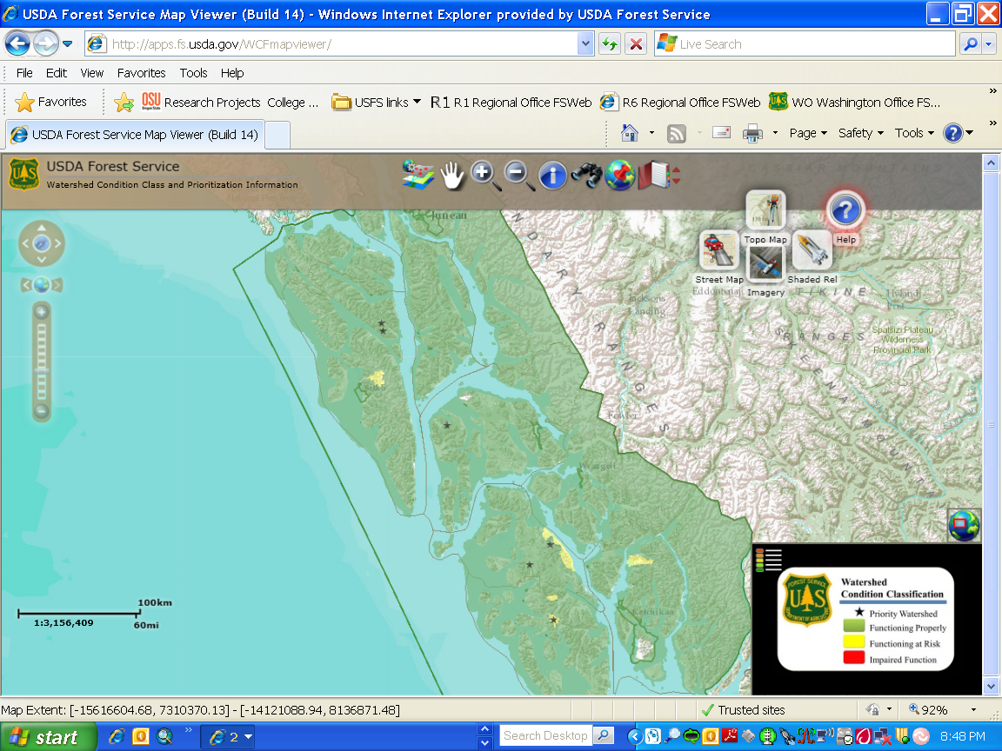
National Map of Condition Class showing Tongass Watersheds
Notes:
Interactive map available to the public

Slide 16
Step A - Condition Class Results
Tongass watersheds in the realm of either:
Class I (green – 1.0 – 1.6 rating) “Functioning Properly” or
Class II (yellow – 1.7 – 2.2 rating) “Functioning at Risk”
A number are right at the cusp of a Class II watershed

Slide 17
Tongass Watershed Condition Class sub-class ratings
Green shades = 1 to 1.4
Yellow shades = 1.5 to 1.9

Slide 18
Watershed Condition Framework
STEP A
Classify Watershed Condition
STEP C
Develop Watershed Action Plans
STEP D
Implement Integrated Projects
STEP E
Track Restoration Accomplishments
STEP F
Monitor and Verification
STEP B
Prioritize Watersheds for Restoration

Slide 19
Step B: Prioritize Watersheds for Restoration
Small number of Priority Watersheds equivalent to a 5-year program of work for each admin unit (approx 1-5)
Implementation Guidance – FS-977
Collaborate with Stakeholders and Partners
Ecological, social, and economic considerations
Align with national/ regional strategies and Forest Plan direction
Align with outside agency efforts and partnership opportunities
Selection and prioritization rationale entered into WCATT database

Slide 20
Current Tongass Priority Watersheds
Twelvemile – Prince of Wales Island 1.7 rating
Luck/Eagle – Prince of Wales Island 1.5 rating
Saginaw – North Kuiu Island 1.5 rating
Staney – Prince of Wales Island 1.6 rating
Sitkoh – Chichagof Island 1.5 rating

Slide 21
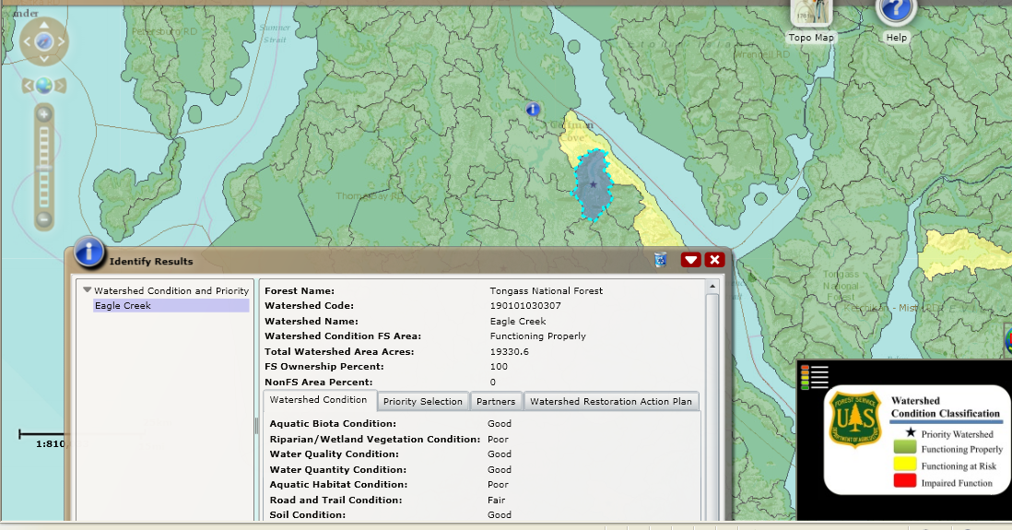
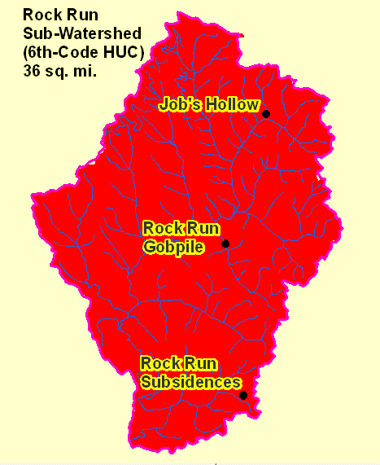
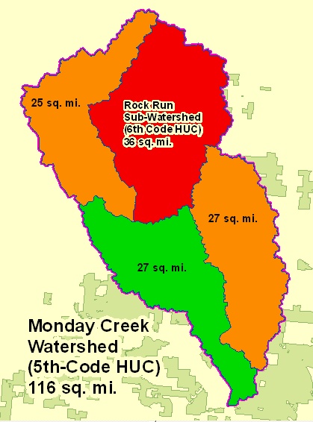
Step B: Identify Priority Watersheds
Eastern Region
USDA Forest Service
Rock Run Priority Watershed
Wayne NF

Slide 22
Step B: Identify Priority Watersheds
Eastern Region
USDA Forest Service
Rock Run Priority Watershed
Wayne NF

Slide 23
Step B: Identify Priority Watersheds
Eastern Region
USDA Forest Service
Rock Run Priority Watershed
Wayne NF

Slide 24
Watershed Condition Framework
STEP A
Classify Watershed Condition
STEP C
Develop Watershed Action Plans
STEP D
Implement Integrated Projects
STEP E
Track Restoration Accomplishments
STEP F
Monitor and Verification
STEP B
Prioritize Watersheds for Restoration

Slide 25
Step C: Watershed Restoration Action Plans
Implementation Guidance- FS-977
Work with stakeholders and potential partners to:
Conduct field assessment to document specific problems
Identify ‘essential projects’ that address specific problems
Identify potential partners and funding sources
Develop implementation schedule & monitoring plan

Slide 26
Step C: Develop Watershed Action Plan
Wayne NF

Slide 27
Watershed Condition Framework
March 31, 2011
STEP A
Classify Watershed Condition
STEP C
Develop Watershed Action Plans
STEP D
Implement Integrated Projects
STEP E
Track Restoration Accomplishments
STEP F
Monitor and Verification
STEP B
Prioritize Watersheds for Restoration
July 15, 2011
Prioritization guidance provided in 2011 Budget Direction
September 30, 2011
FY 2012 and beyond

Slide 28
Step D: Implement Integrated Suites of Essential Projects
May take 1 -5 years
Implementation includes:
Planning (NEPA)
Project design
Project completion
Completion information entered into corporate database

Slide 29
Step E: Track Restoration Accomplishments
Track accomplishments in appropriate corporate databases
Watershed Inventory Tracking database
Workplan

Slide 30
Step F: Monitor and Verification
Verify accomplishment of project activities and monitor improvements to watershed and stream condition
Did we do what we said we were going to do? (Tier 1)
Did our work produce the results we predicted (Tier 2)

Slide 31
In summary
The Watershed Condition Framework provides:
a consistent, comparable, credible process for building accountability in watershed restoration.
a comprehensive approach for integrated restoration on watersheds on National Forests and Grasslands.
an outcome-based performance measure for documenting improvement to watershed condition at Forest, Regional, and National scales.
a transparent way to demonstrate that the FS is a good investment in watershed restoration

Slide 32
QUESTIONS?

